Slide 1
Parasite Genomics Transcriptome analysis using RNA-seq
Adam Reid & Steve Doyle
Wellcome Sanger Institute/LSHTM
LSHTM Pathogen Genomics

Slide 2
Summary
RNA-seq background
Mapping to the genome (HISAT2 and Artemis)
Mapping to the transcriptome and counting reads (Kallisto)
Read count normalisation
Differential expression (Sleuth)
What to do with a gene list
The exercise

Slide 3
Gene expression

Slide 4
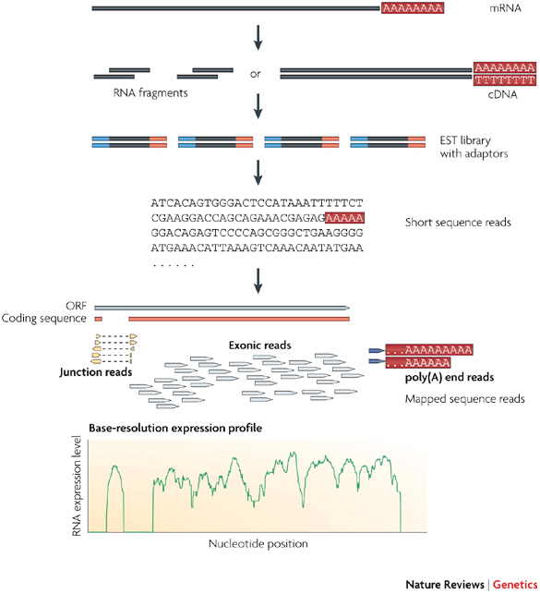
RNA sequencing

Slide 5
Experimental design
Replicates
Relevant biological replicates are required
Technical replicates are not generally required, but try to arrange samples on plates to minimise potential problems
Sequencing depth
Practical considerations e.g. amount of data on one lane, number of barcodes/tags
Suggested 2-5Gb for human, 0.5-1Gb for Plasmodium, but depends greatly on complexity of samples and how obvious the interesting biology is

Slide 6
Mapping RNA-seq reads to the genome (HISAT2)
Mapping to the genome is great for determining whether your RNA-seq data is of high quality and exploring the structure of genes of interest
Eukaryotic genes have introns, which are not present in mature mRNA so special mapping algorithms are required
HISAT2 is only one such algorithm, but is accurate, fast and easy to use

Slide 7
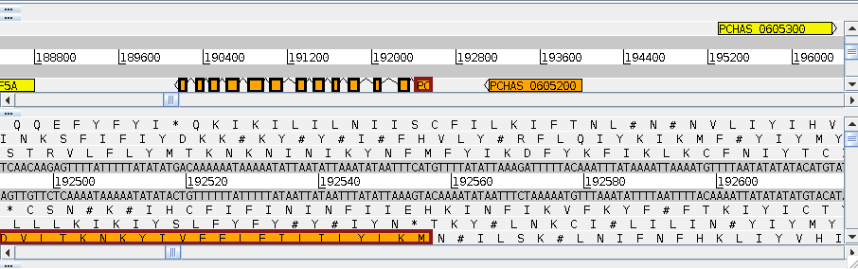
Artemis Genome Browser

Slide 8
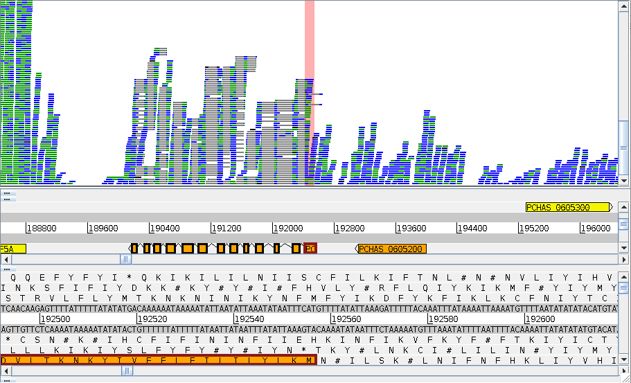

Slide 9
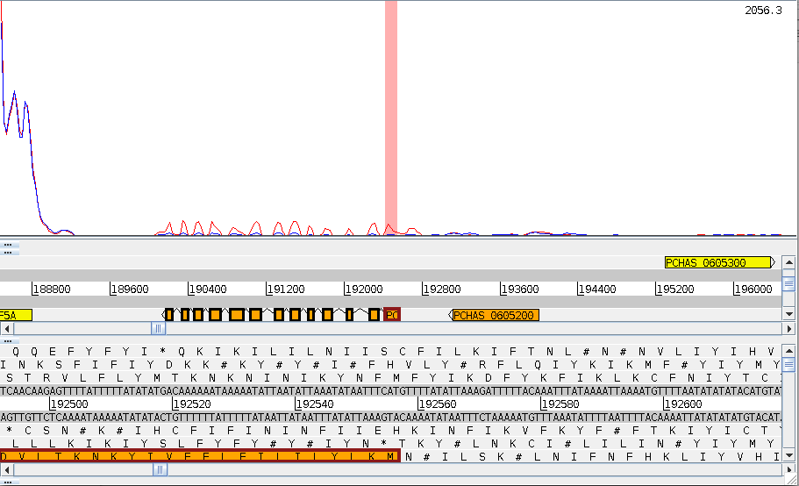

Slide 10
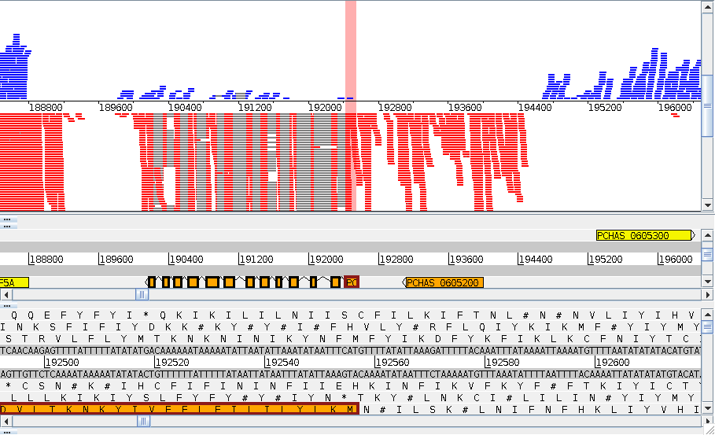

Slide 11
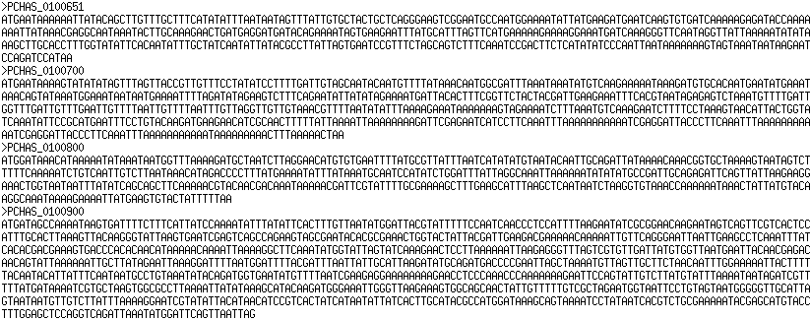
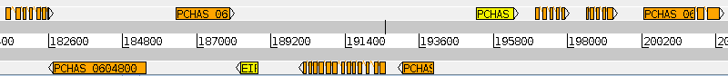
Mapping to the transcriptome and counting reads (Kallisto)
Transcript sequence FASTA file
Genome sequence FASTA file
+
Multiple splice forms per gene introduce ambiguity into the mapping
Mapping to the spliced transcript sequences allows this ambiguity to be taken into account and allows transcript-specific read counts
It is also faster because there is less target sequence
Recent improvements in algorithms (pseudoalignment) make this even faster
Counting comes for free

Slide 12
Normalisation
Read counts are biased because each sample will have a different total number of reads (solved by CPM)
Different transcripts have different lengths, so we expect more reads from a longer transcript than a shorter one, even if the expression levels are the same (solved by RPKM/FPKM)
However, RPKM has problems with highly expressed genes, so most methods use more complicated normalisation procedures (DESeq2 rlog, Sleuth)
FPKM = RPKM for paired end reads

Slide 13
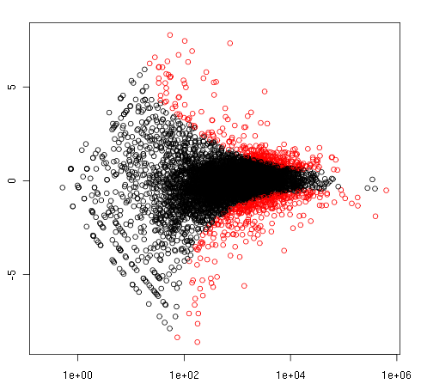
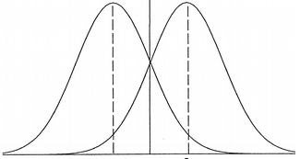
Determining differential expression (Sleuth)
We normally don’t have enough replicates to do traditional tests of significance for RNA-seq data
Instead most methods look for outliers in the relationship between average abundance and fold change, assuming most genes are not differentially expressed
gene A, condition 1
gene A, condition 2
Log fold change
M
Normalised read counts
Average abundance

Slide 14
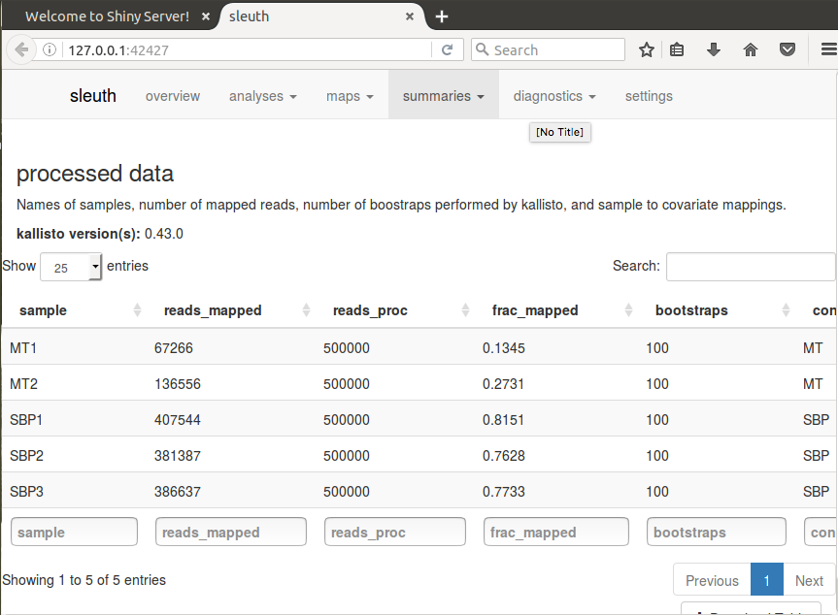
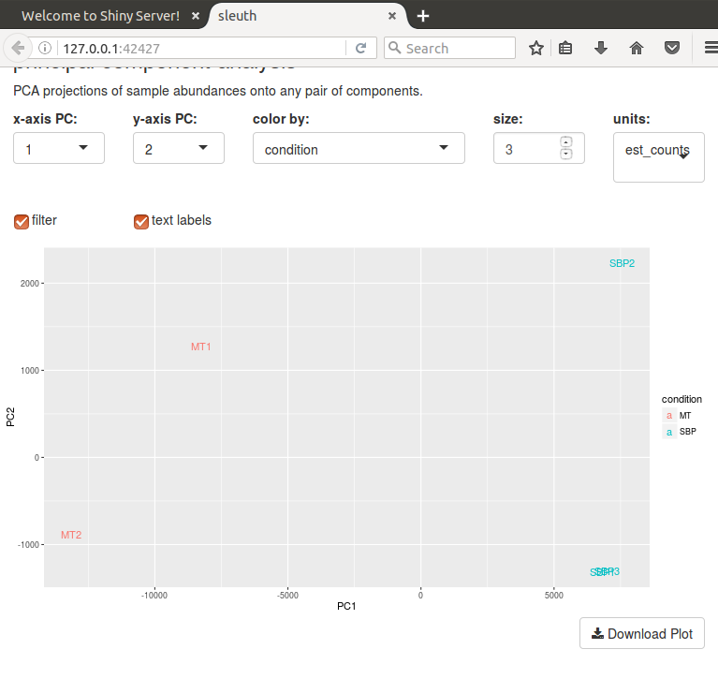
QC with Sleuth

Slide 15
What to do with a gene list
What we have covered so far is well established methodology, which is generally applicable to most experiments
When you have a list of differentially expressed genes, things start to get difficult. What to do:
Have a hypothesis already? Test it.
GO term/pathway analysis (GSEA, TopGO, InnateDB, Ingenuity Pathway Analysis etc.)
Work through list, Google, read papers
Overlay datasets on essentiality, populations, mutations, Pfam domains, chromosomal location, expression, proteome…
Then make a hypothesis about what genes are interesting and why. Can you test/explore this further bioinformatically? Design the next wet lab experiment.

Slide 16
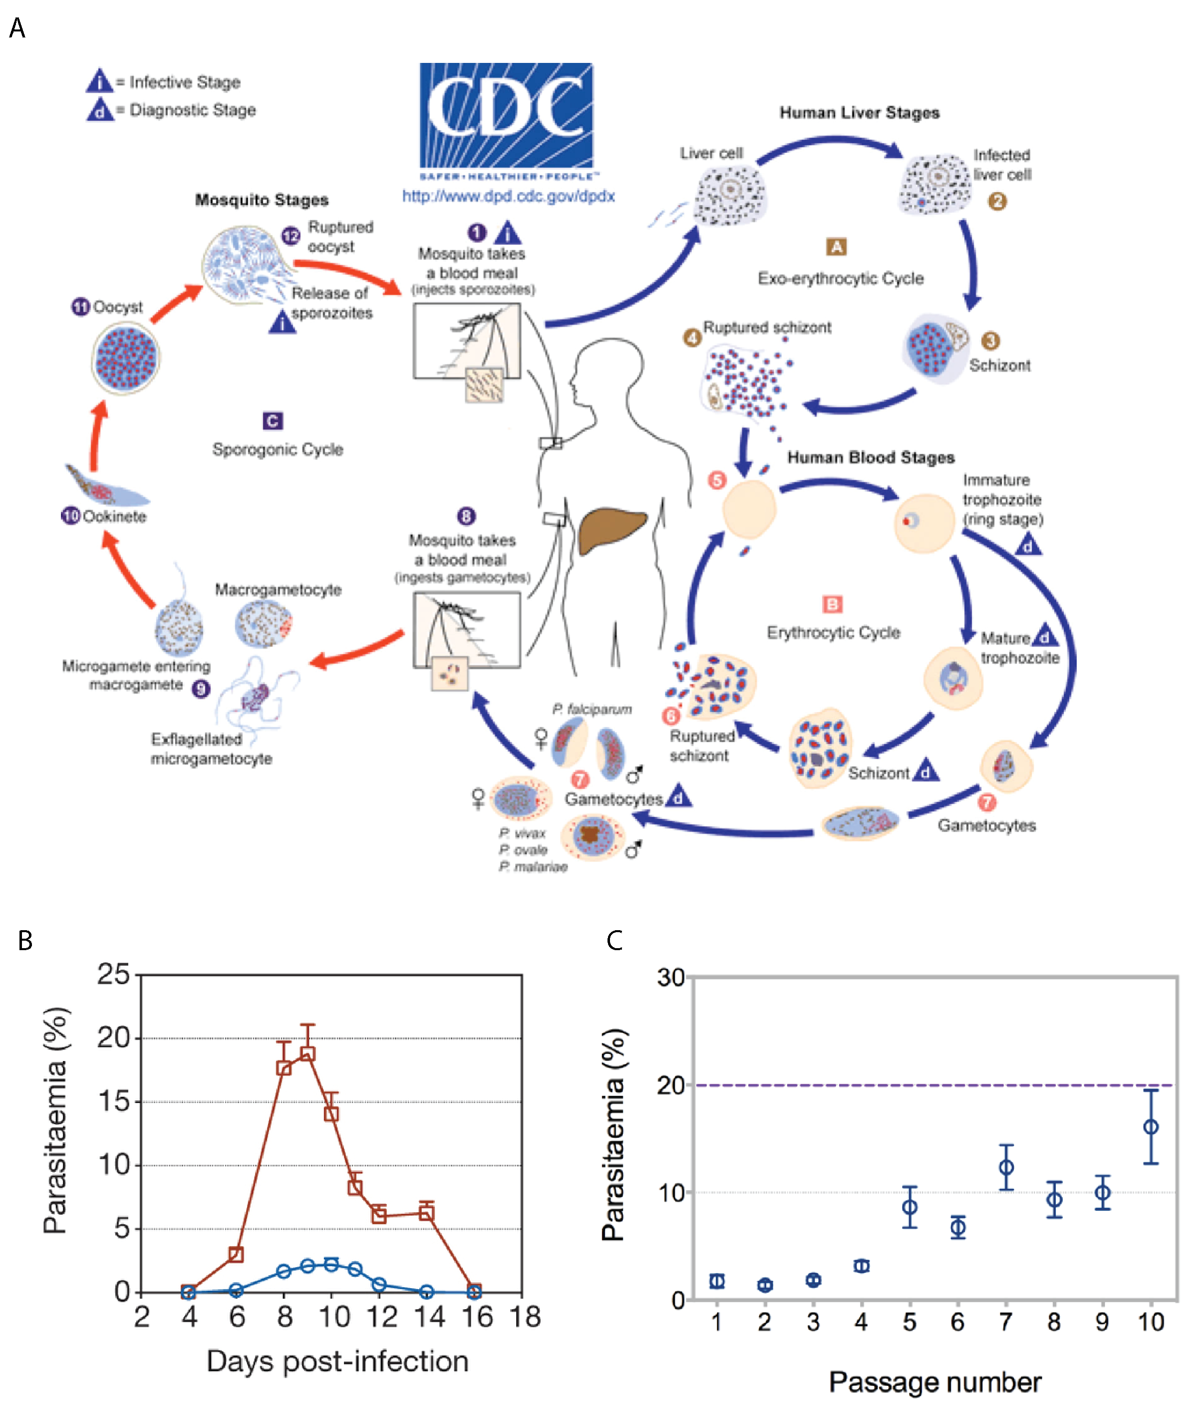
Today’s exercise

